Slide 1

Bengaluru Used Cars Price Analysis
by:
Kasarla Shravya
Vellaturi Phanindraamouli
Madhavi

Slide 2
About us
KASARLA SHRAVYA
I’m a 2022 B.Tech graduate in Electrical and Electronics stream from GNITS.
I’m an data enthusiast. I enjoy the challenge of diving into datasets, transforming raw data into valuable insights, exploring data patterns, uncovering trends, and making data-driven decisions.
LinkedIn: https://www.linkedin.com/in/shravya-kasarla/
GitHub: https://github.com/ShravyaKasarla
VELLATURI PHANINDRAAMOULI
I have my Bachelors Degree in Computer Science And Engineer(2023) from VVIT.
I’m interested in data science because it combines my passion for problem-solving with the power of data to drive meaningful insights and decisions
LinkedIn: www.linkedin.com/in/vellaturi-phanindraamouli
GitHub: https://github.com/phanindraamouli
MADHAVI SRIRAM
I hold a Master’s degree in Computer Applications (MCA), completed in 2022.
I am passionate about data analysis and enjoy transforming complex datasets into actionable insights to drive business decisions.
LinkedIn: https://www.linkedin.com/in/madhavi-sri-ram-8a0b25241/
GitHub: https://github.com/Madhavi98-sys

Slide 3
Problem Statement
To analyze Bengaluru used car market and understand the factors that influence car prices.
Objective of the Project
By using historical data of used cars in Bengaluru, this project aims to:
Identify key factors (such as brand, Year of Manufacture, Fuel type) that most strongly affect the resale value of cars.
Provide insights into trends in car demand and pricing patterns to assist buyers, sellers, and dealers in making informed decisions.

Slide 4

Data Collection - Web Scraping
Website: CarTrade
Website URL: https://www.cartrade.com/
We chose data analyze of Used Cars from Benguluru City
URL: https://www.cartrade.com/buy-used-cars/bangalore/c/page-2/#so=-1&sc=-1&city=2
Above URL is 2nd Page URL, we scraped data from 30 pages
We used ‘BeautifulSoup’, ‘requests’ Libraries for scraping data from website

Slide 5
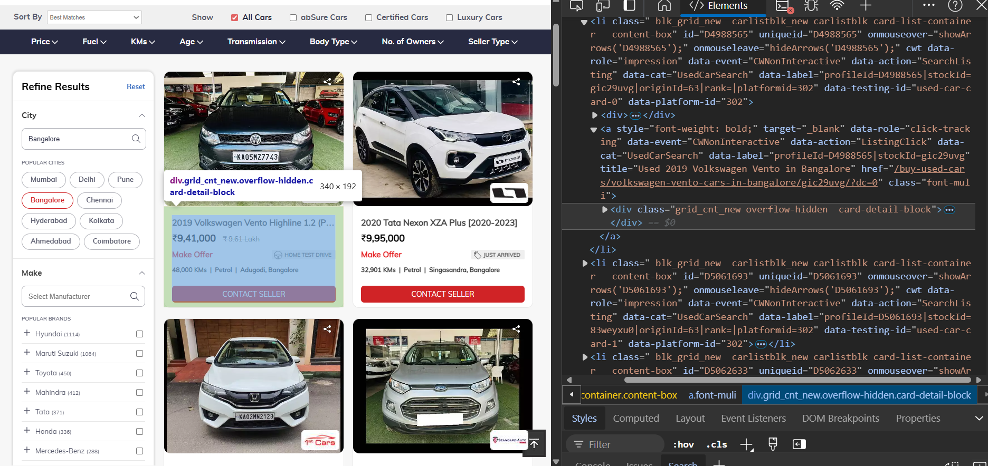
Website Interface

Slide 6
Summary of the Data
Initially we scrapped Car Name(Year, Brand Name, Model), Price, Info(KMs Driven, Fuel Type, Location) and saved into a data frame
And then extracted
Year of Manufacture, Brand, Model from Car Name.
KMs Driven, Fuel Type, Location from Info
Then furtherly cleaned the Price, KMs Driven, Location, Model
And then converted numerical columns(Year of Manufacture, KMs Driven) to int type.
Next, we defined a column 'car age category’ based on its age
New : <= 3 years
Moderate: 3 – 8 years
Old : > 8 years
Reordered the columns based on requirement and saved to csv file.

Slide 7
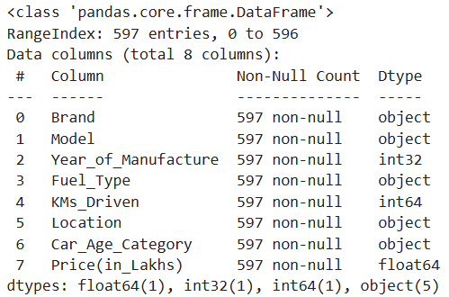
Data Cleaning
Initially, data has 720 rows and 8 columns
Type conversion: Changed datatypes from object to respective datatypes.
Null Values : No null values
Duplicate rows : 123 duplicate rows identified and dropped.

Slide 8
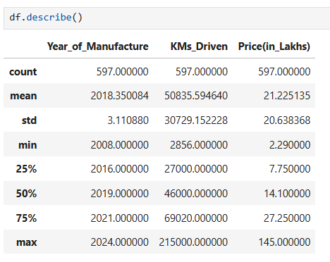
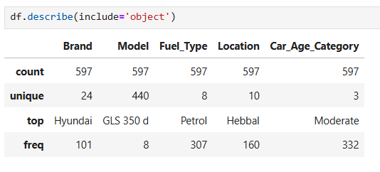
Data Description
KMs Driven : Max >>> Q3, hence it may have outliers and is right-skewed
Price(in Lakhs) : Max >>> Q3, hence it may have outliers and is right-skewed

Slide 9
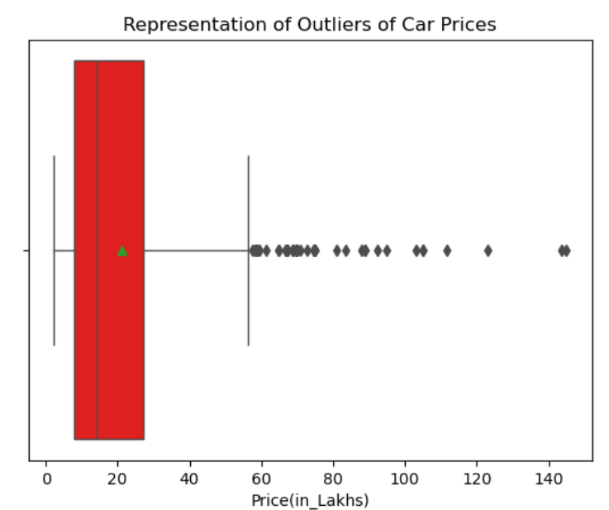
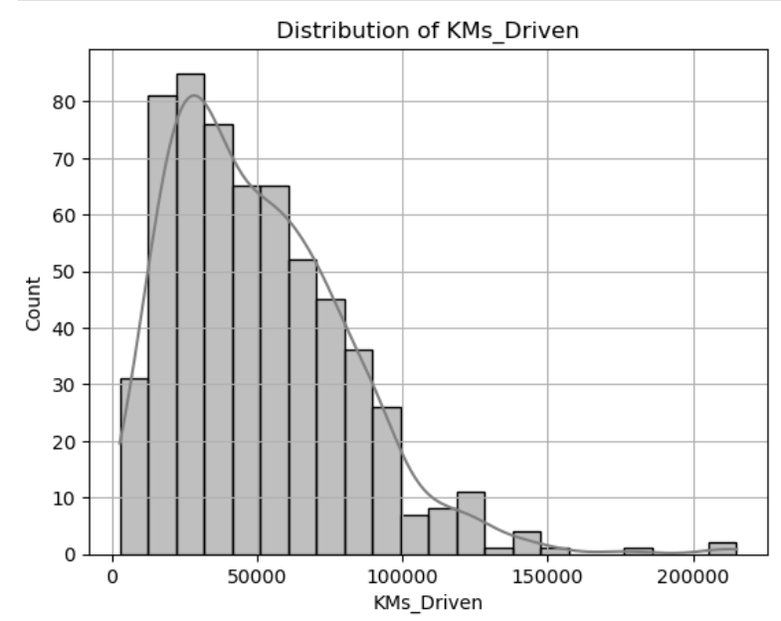
Univariate Analysis - analysing a single variable in the dataset
Prices
KMs Driven
The majority(50%) of car prices are concentrated between 10 and 30 lakhs, and a small but significant portion are priced much higher, reaching up to 140+ L
Most cars are moderately priced, a small segment of high-end cars drives the overall average price up.
Most of the cars have been driven between (10,000 - 60,000) kms, this indicates that the majority of cars in this dataset are relatively lightly used
This distribution suggests most that most of the cars are mostly moderately used

Slide 10
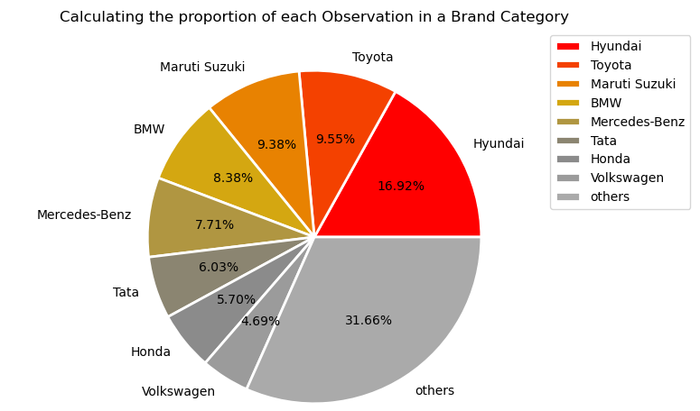
Brand
Hyundai Cars are more in number followed by Toyota and Maruti Suzuki.
*Others - Mahindra, Ford, Renault, Kia, Jeep, Skoda, MINI, Audi, Mitsubishi, Land Rover, Volvo, Nissan, MG, Jaguar, Porsche, Datsun

Slide 11
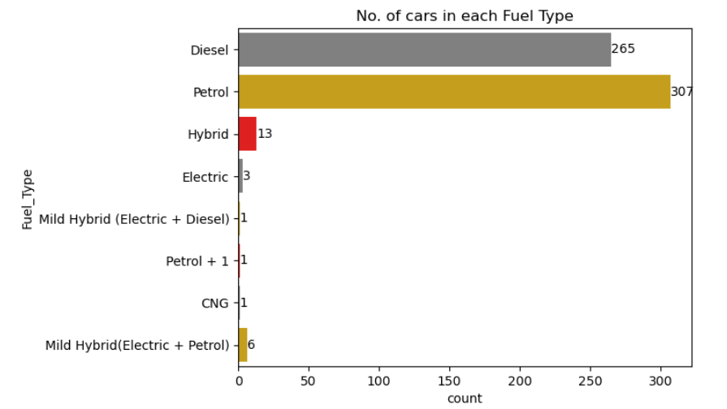
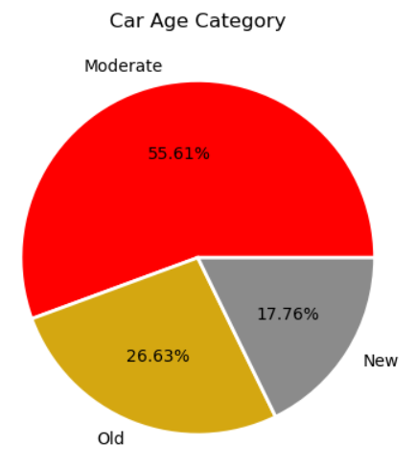
Fuel Type
Car Age Category
Most of the cars are of Petrol and Diesel.
Other fuel types occupying a share of 2.01%, have fewer listings, indicating fewer models available in the used car market
Moderate (i.e., Cars aged 3-8 years) are listed more with 332 cars occupying 55.61% followed by Old (> 8 years) and new(< 3 years).

Slide 12
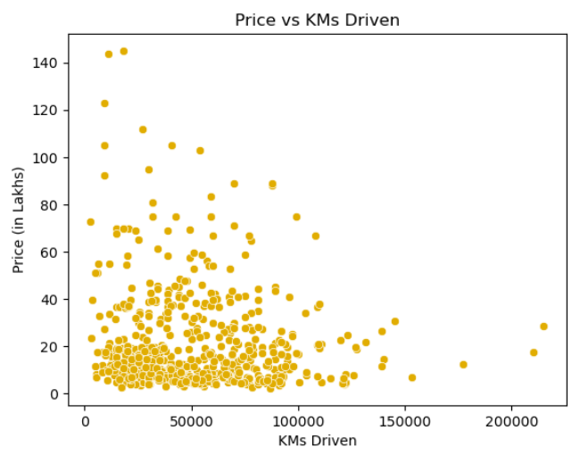
Bivariate Analysis - analysing a single variable in the dataset
KMs Driven
vs
Price(in Lakhs)
Cars with more KMs driven tend to have lower prices.

Slide 13
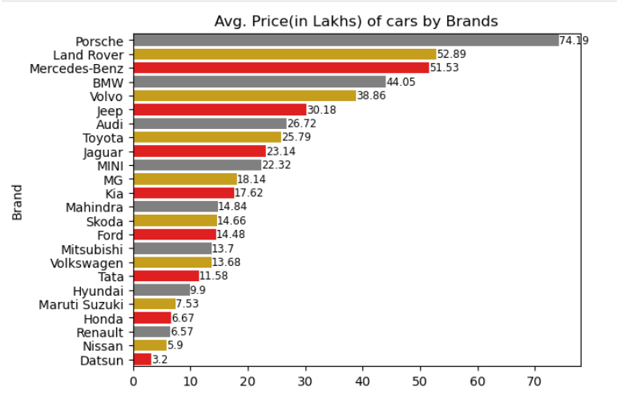
Brand vs Price(in Lakhs)
High end brands like Porsche Land Rover, Mercedes-Benz, BMW has high prices
And Cars like Hyundai, Tata Maruti Suzuki has affordable prices

Slide 14
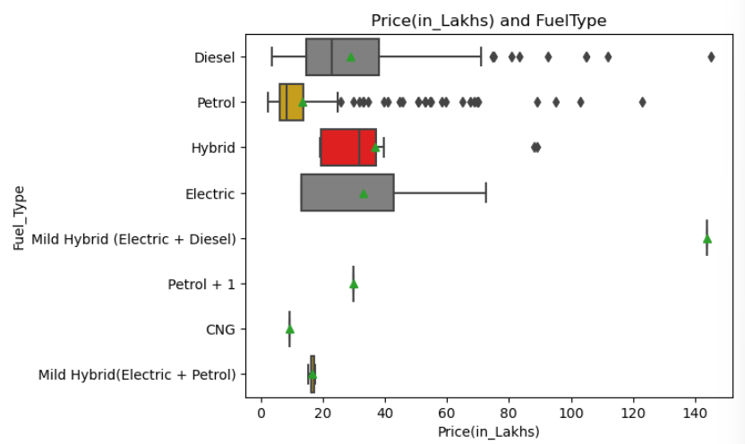
Fuel Type vs Price(in Lakhs)
Diesel cars are more expensive than Petrol ones
Petrol cars come in a variety of prices
CNG cars are the cheapest option, but they not be able to find everywhere

Slide 15
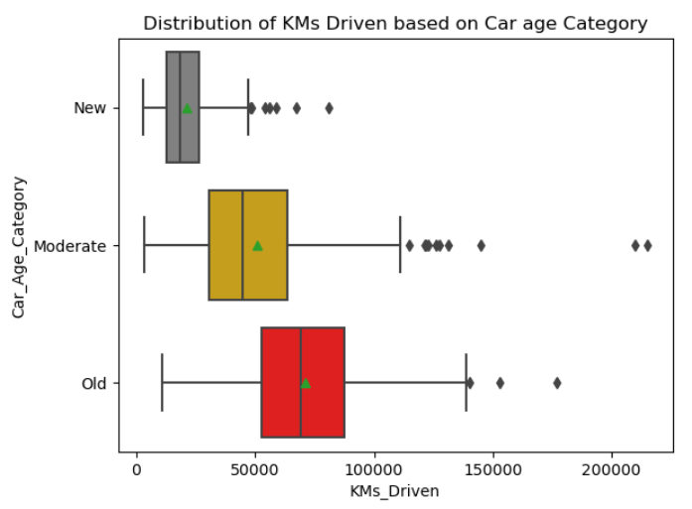
Car Age Category vs KMs Driven
Moderately aged cars have a wider range, suggesting more variability in usage, with outliers while older cars also having wider range and more kilometers driven, but have a few high outliers.
We can see , older the car, more KMs driven.

Slide 16
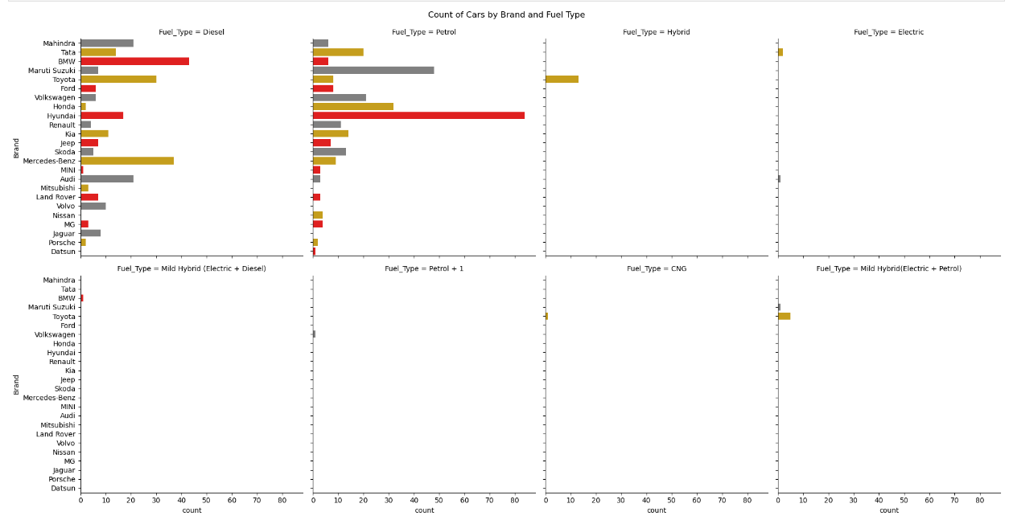
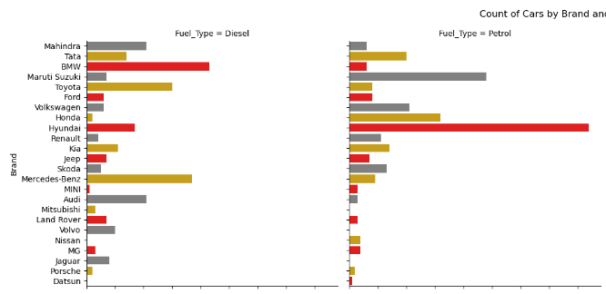
Brand vs Fuel Type
The most common fuel types appears to be Petrol and Diesel, with Maruti Suzuki, Hyundai having a significant number of Petrol cars and BMW, Mercedez-Benz having significant Diesel cars in this category.
Other fuel types such as Hybrid and Electric have fewer occurrences, with only a few brands like Toyota having notable counts for Hybrid.
The graph highlights clear distinctions in fuel preferences among different car brands.

Slide 17
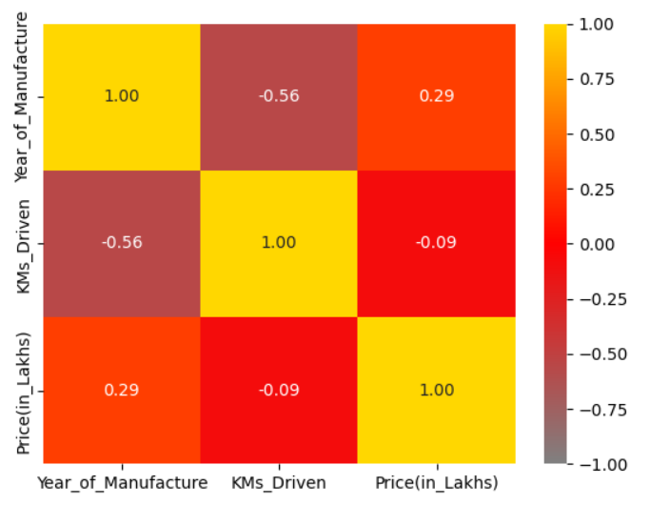
Multi-Variant Analysis
There is a strong negative correlation between Year of Manufacture and KMs Driven indicating ‘Older cars has driven more’.
A positive correlation between Price and Year of Manufacture would show that ‘newer cars tend to have higher prices’.
There is slight negative correlation between Price and KMs Driven might indicate that ‘cars more KMs Driven tend to have lower prices’.

Slide 18
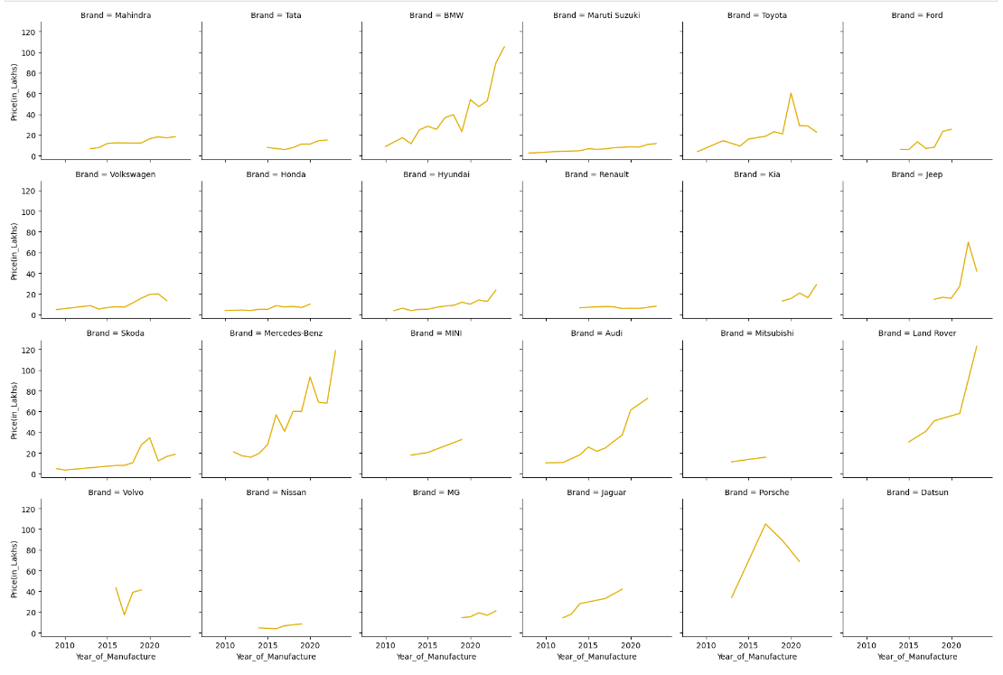
Brand
vs
Year
vs
Price

Slide 19
Brand vs Year of Manufacture vs Price(in_Lakhs)
Brands like BMW, Mercedes Benz, Audi, and Land Rover show a gradual steep increase in price over the years and brands like Mahindra, Tata, Maruti Suzuki, Volkswagen and Hyundai, the prices remain relatively stable over time.
Honda, Hyundai, Maruti Suzuki and Renault show little variation in price across different years. This might suggest that older used models from these brands have a consistent demand in the used car market, and prices stabilize after the initial depreciation period.
Luxury brands like BMW, Mercedes Benz, Audi, Jaguar and Land Rover exhibit a slower depreciation rate in the used car market. These brands often maintain higher resale values due to their brand reputation, reliability, and desirability, even after several years.

Slide 20
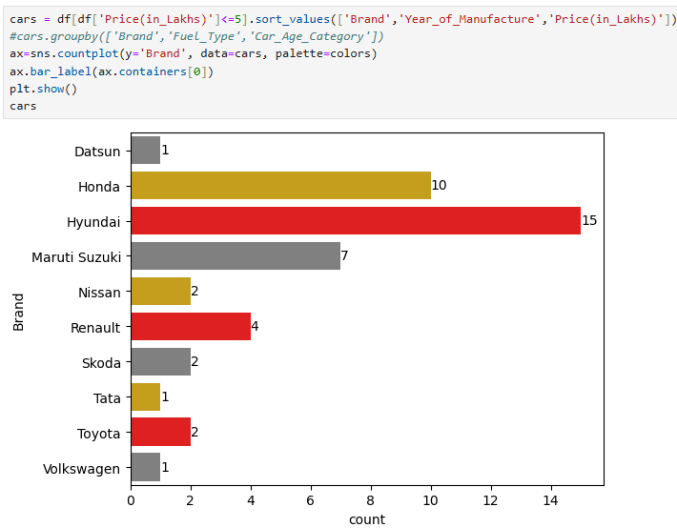
Scenario
Q. A person wants to buy a second hand car with in a budget of 5 lakhs.
Suggest cars whose prices are under 5 lakhs

Slide 21
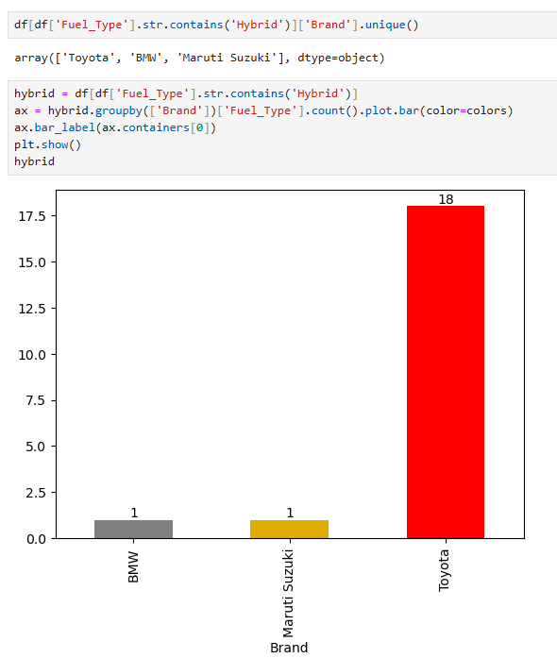
Q. A person wants to know which brands offer Hybrid Cars
(Hybrid includes Hybrid, Mild Hybrid (Electric + Diesel), Mild Hybrid(Electric + Petrol))

Slide 22
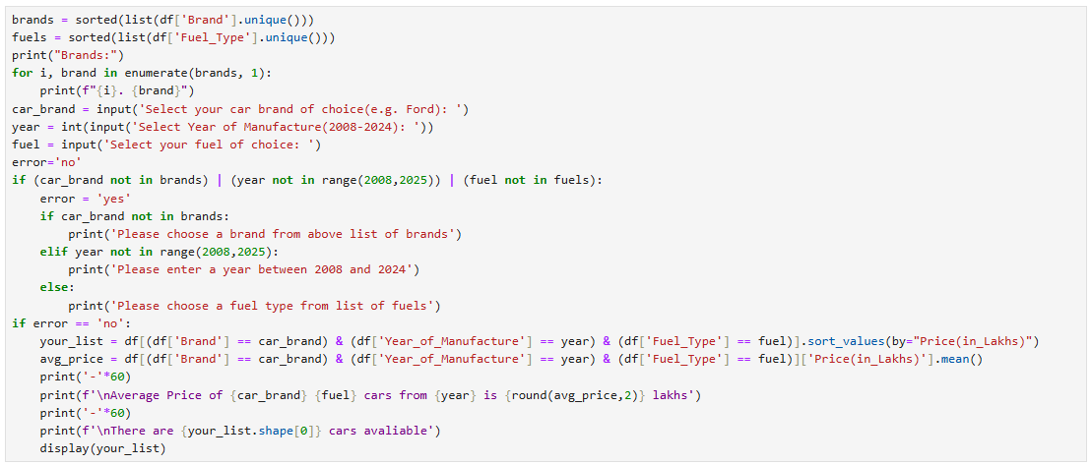
Q. Based on User preferences Brand, Year, Fuel. Suggest average price of car

Slide 23
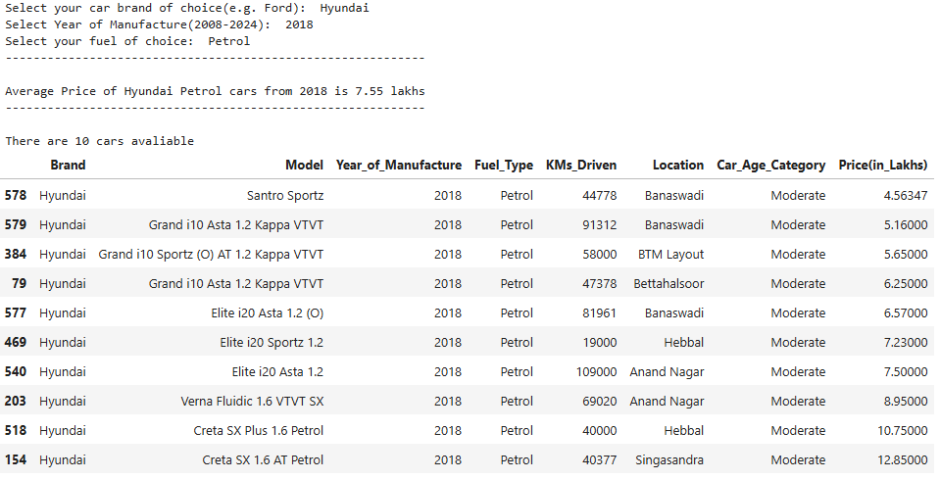

Slide 24
Conclusion
Hyundai cars are available in affordable range and more in number followed by Maruti Suzuki, in used cars market
95% cars are Petrol and Diesel, while others fuel types are very less in used cars market
Petrol cars are in spread wide range price, where as diesel are costlier than petrol ones
On Overall, Year of Manufacture, KMs Driven, Fuel Type , Brand has influenced has Price of used cars.

Slide 25
Q&A

Slide 26

THANK YOU

